Slide 1

Introduction to Tally
Tally is an accounting software used to record, manage, and analyze financial transactions of a business.
It helps businesses maintain:
Accounts (income & expenses)
Inventory (stock management)
Tax calculations (GST, etc.)
👉 Developed by Tally Solutions Pvt Ltd, India
Short History of Tally
1986 → First version of Tally launched
Developed in India
Popular version: Tally ERP 9
Latest version: Tally Prime

Slide 2
Why Do We Use Tally?
Tally is used to simplify accounting work and reduce manual effort.
Main Reasons:
Manual accounting is time-consuming
Chances of errors are high
Difficult to manage large data
Note: 👉 Tally solves all these problems by automation

Slide 3
Key Features of Tally
Easy to use interface
Fast data entry
Automatic calculations
GST support
Inventory management
Report generation (Profit & Loss, Balance Sheet)
Tally is widely used in different sectors:
Small & Medium Businesses (SMEs)
Retail Shops
Chartered Accountant Offices
Manufacturing Companies
Service-based Companies

Slide 4
Pros and Cons of Tally
Pros:
User-friendly
Reliable and accurate
Widely used in India
Supports GST
Cons:
Paid software
Requires basic accounting knowledge
Limited customization compared to advanced ERP systems

Slide 5
What is Debit and Credit in Tally?
Basic Meaning
Debit (Dr) → “Value comes in” or increase in assets/expenses
Credit (Cr) → “Value goes out” or increase in liabilities/income
👉 In Tally, every transaction follows double-entry system:
Every Debit has a corresponding Credit

Slide 6
Practice Questions
Mr. Sharma purchased a laptop in cash ₹22,000.
Mr. Sharma purchased an office desk ₹6,000 and office chair ₹3,500 in cash.
Mr. Sharma opened a bank account in HDFC Bank by depositing cash ₹40,000.
Mr. Sharma purchased stationery items in cash ₹3,200.
Mr. Sharma purchased a printer ₹8,000 from Gupta Traders on credit.
Mr. Sharma paid cash ₹8,000 to Gupta Traders.

Slide 7
1. Purchased laptop for cash ₹22,000
Laptop (Asset ↑) → Debit
Cash ↓ → Credit
Laptop A/c Dr 22,000 To Cash A/c 22,000
2. Purchased desk & chair ₹9,500
(6000 + 3500)
Furniture (Asset ↑) → Debit
Cash ↓ → Credit
Furniture A/c Dr 9,500 To Cash A/c 9,500
3. Deposited cash into bank ₹40,000
Bank (Asset ↑) → Debit
Cash ↓ → Credit
Bank A/c Dr 40,000 To Cash A/c 40,000

Slide 8
4. Purchased stationery ₹3,200
Stationery (Expense) → Debit
Cash ↓ → Credit
Stationery A/c Dr 3,200
To Cash A/c 3,200
5. Purchased printer on credit ₹8,000
Printer (Asset ↑) → Debit
Gupta Traders (Creditor ↑) → Credit
Printer A/c Dr 8,000
To Gupta Traders A/c 8,000
6. Paid cash to Gupta Traders ₹8,000
Gupta Traders (Liability ↓) → Debit
Cash ↓ → Credit
Gupta Traders A/c Dr 8,000
To Cash A/c 8,000

Slide 9
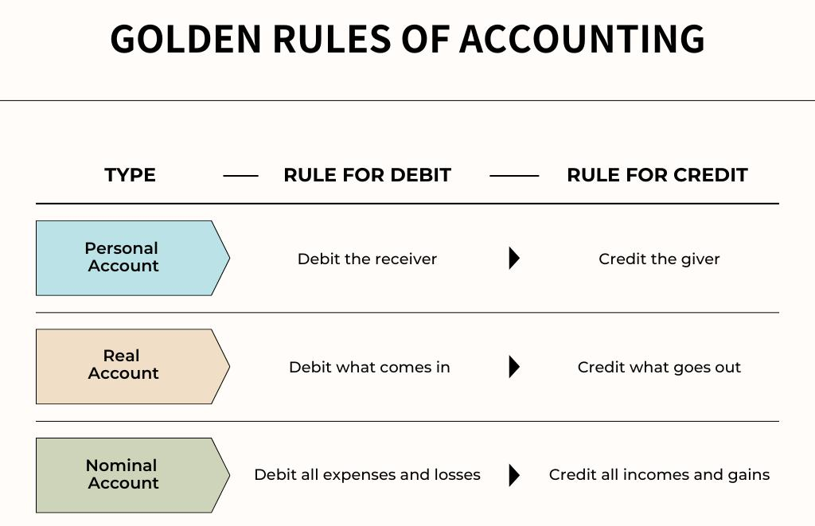

Slide 10
1 Real Account (Assets)
Represents assets (things owned by business)
Examples:
Cash
Bank
Furniture
Computer
Rule: Debit what comes in, Credit what goes out
2 Personal Account
Represents person, company, or organization
Examples:
Ram
Gupta Traders
Bank (as institution)
Rule: Debit the receiver, Credit the giver
3 Nominal Account
Represents expenses, losses, income, gains
Examples:
Salary
Rent
Commission
Interest
Rule:
Debit all expenses and losses, Credit all incomes and gains

Slide 11
Practice Questions
Q1. Mohan Purchased furniture for cash ₹12,000
Q2. Mohan Paid salary ₹6,000
Q3. Mohan Received commission ₹2,500
Q4. Mohan Purchased goods from Raj Traders on credit ₹9,000
Q5. Mohan Paid cash to Raj Traders ₹9,000
Q6. Mohan Paid rent ₹4,000 in cash
Q7. Mohan Received cash from Mohan ₹7,000
Q8. Mohan Purchased computer on credit from Star Computers ₹25,000
Q9. Mohan Paid electricity bill ₹2,200
Q10. Mohan Received interest ₹1,500 in bank

Slide 12
Q1 Solution
Furniture → Real Account (Asset)
Cash → Real Account
Entry:
Furniture A/c Dr 12,000
To Cash A/c 12,000
Q2 Solution
Salary → Nominal Account (Expense)
Cash → Real Account
👉 Entry:
Salary A/c Dr 6,000
To Cash A/c 6,000
Q3 Solution
Cash → Real Account
Commission → Nominal Account (Income)
Entry:
Cash A/c Dr 2,500
To Commission A/c 2,500
Q4 Solution
Purchases → Nominal Account
Raj Traders → Personal Account
Entry:
Purchases A/c Dr 9,000
To Raj Traders A/c 9,000

Slide 13
Q5 Solution
Raj Traders → Personal Account
Cash → Real Account
Entry:
Raj Traders A/c Dr 9,000
To Cash A/c 9,000
Q6 Solution
Rent → Nominal Account (Expense)
Cash → Real Account
Entry:
Rent A/c Dr 4,000
To Cash A/c 4,000
Q7 Solution
Cash → Real Account
Mohan → Personal Account
Entry:
Cash A/c Dr 7,000
To Mohan A/c 7,000
Q8 Solution
Computer → Real Account (Asset)
Star Computers → Personal Account
👉 Entry:
Computer A/c Dr 25,000
To Star Computers A/c 25,000

Slide 14
Q9 Solution
Electricity → Nominal Account (Expense)
Cash → Real Account
Entry:
Electricity A/c Dr 2,200
To Cash A/c 2,200
Q10 Solution
Bank → Real Account
Interest → Nominal Account (Income)
Entry:
Bank A/c Dr 1,500
To Interest A/c 1,500

Slide 15
3 Types of Organization in Tally
1. Service Organization
Provides services, not physical goods
Examples:
Coaching institute
IT company
Consultancy services
Repair services
Features:
No inventory (stock)
Income comes from services
Simple accounting
In Tally:
Focus on income & expenses
No need for stock management

Slide 16
2. Trading Organization
Buys and sells finished goods
Examples:
Retail shop
Wholesale business
E-commerce seller
Features:
Has inventory (stock)
Profit = Selling Price – Purchase Price
No production process
In Tally:
Use Purchase & Sales entries
Maintain stock/inventory

Slide 17
3. Manufacturing Organization
Produces goods using raw materials
Examples:
Factory
Food production unit
Garment manufacturing
Features:
Converts raw material → finished goods
Includes production process
Complex accounting
In Tally:
Use Stock + Manufacturing entries
Maintain:
Raw Material
Work in Progress
Finished Goods

Slide 18
Pre-defined Groups in Tally (Primary Groups)
💳 1. Capital Account
👉 Owner’s investment in the business.
(Example: Owner’s capital, drawings)
💳 2. Loans (Liabilities)
👉 Borrowed funds that must be repaid.
(Example: Bank loan, unsecured loan)
📉 3. Current Liabilities
👉 Short-term obligations payable within a year.
(Example: Creditors, bills payable)
🏢 4. Fixed Assets
👉 Long-term assets used in business.
(Example: Building, machinery, furniture)
📈 5. Investment
👉 Money invested to earn income.
(Example: Shares, mutual funds)
💰 6. Current Assets
👉 Short-term assets easily converted into cash.
(Example: Cash, bank, stock, debtors)

Slide 19
📊 7. Miscellaneous Expenses (Assets)
👉 Expenses not written off completely.
(Example: Preliminary expenses)
⚖️ 8. Suspense Account
👉 Temporary account for unknown transactions.
(Used until error is identified)
🏬 9. Branch / Division
👉 Accounts of different branches of a business.
💵 10. Sales Account
👉 Income from sale of goods/services.
🛒 11. Purchase Account
👉 Cost of buying goods for business.
📥 12. Direct Income
👉 Income directly related to business activity.
(Example: Service income)
📤 13. Direct Expenses
👉 Expenses directly related to production.
(Example: Wages, carriage)
📥 14. Indirect Income
👉 Income not directly related to main business.
(Example: Interest received)
📤 15. Indirect Expenses
👉 General business expenses.
(Example: Salary, rent, electricity

Slide 20
Secondary Groups in Tally
💳 1. Reserve & Surplus (Capital Account)
👉 Profits kept in business for future use.
(Example: General reserve)
💳 2. Bank Overdraft (Loans Liabilities)
👉 Amount withdrawn from bank more than balance.
🏦 3. Secured Loans (Loans Liabilities)
👉 Loans taken against security.
(Example: Loan against property)
📄 4. Unsecured Loans (Loans Liabilities)
👉 Loans taken without security.
🧾 5. Duties & Taxes (Current Liabilities)
👉 Taxes payable to government.
(Example: GST, VAT)
📊 6. Provision (Current Liabilities)
👉 Amount set aside for future expenses/losses.
🤝 7. Sundry Creditors (Current Liabilities)
👉 Persons to whom business owes money.

Slide 21
💰 8. Sundry Debtors (Current Assets)
👉 Persons who owe money to business.
📥 9. Deposit Assets (Current Assets)
👉 Deposits made by business.
(Example: Security deposit)
💵 10. Loans & Advances (Assets) (Current Assets)
👉 Money given to others as loan or advance.
💸 11. Cash in Hand (Current Assets)
👉 Physical cash available with business.
📦 12. Stock in Hand (Current Assets)
👉 Goods available for sale (inventory).
🏦 13. Bank Account (Current Assets)
👉 Money deposited in bank account.

Slide 22
What is a Voucher in Tally?
In Tally, a Voucher is a document used to record financial transactions.
👉 Every transaction (payment, receipt, sale, purchase) is entered using vouchers.
Types of Vouchers in Tally
👉 There are mainly two types:
Common Vouchers (used daily)
Special Vouchers (used for special purposes)

Slide 23
Common Vouchers
👉 These are the most important vouchers used in daily accounting.
💸 1. Contra Voucher (F4)
👉 Used for cash and bank transactions within business
Examples:
Cash deposited into bank
Cash withdrawn from bank
💵 2. Payment Voucher (F5)
👉 Used when money is paid
Examples:
Salary paid
Rent paid
Electricity bill paid

Slide 24
💰 3. Receipt Voucher (F6)
👉 Used when money is received
Examples:
Cash received from customer
Income received
💰 4. Journal Voucher (F7)
👉 Used for adjustments and non-cash transactions
Examples:
Depreciation
Outstanding expenses
Transfer entries

Slide 25
🛒 5. Purchase Voucher (F9)
👉 Used when goods are purchased
Examples:
Buying goods for business
💼 6. Sales Voucher (F8)
👉 Used when goods are sold
Examples:
Selling goods to customers
🔻 7. Debit Note (Ctrl + F9)
👉 Used when purchase return happens
Example:
Goods returned to supplier
🔺 8. Credit Note (Ctrl + F8)
👉 Used when sales return happens
Example:
Customer returns goods

Slide 26
Practice Question Debit, Credit, Ledger, Under, Voucher
Mr. Rohit started Universal Business Solutions by bringing in cash of ₹3,00,000.
Mr. Rohit purchased a computer in cash ₹18,000.
Mr. Rohit purchased an office table ₹3,500 and office chair ₹4,000 in cash.
Mr. Rohit opened a bank account in HDFC Bank by depositing cash ₹50,000.
Mr. Rohit purchased stationery items in cash ₹2,000.
Mr. Rohit purchased a mobile phone ₹5,000 from Raj Telecom on credit.
Mr. Rohit withdrew ₹10,000 from HDFC Bank.
Mr. Rohit paid cash ₹5,000 to Raj Telecom.
Mr. Rohit received a bill of ₹4,500 from Sukun Offset for printing office stationery.
Mr. Rohit paid ₹2,800 by cheque towards office rent.
Mr. Rohit paid ₹700 in cash towards electricity charges.
Mr. Rohit issued a cheque of ₹4,500 to Sukun Offset.
Mr. Rohit withdrew ₹4,000 from HDFC Bank for personal use.

Slide 27
1. Started business with cash ₹3,00,000
Cash A/c → Debit (Current Asset)
Capital A/c → Credit (Capital Account)
Voucher → Journal (F7)
Cash A/c Dr 3,00,000
To Capital A/c 3,00,000
2. Purchased computer in cash ₹18,000
Computer A/c → Debit (Fixed Asset)
Cash A/c → Credit (Current Asset)
Voucher → Payment (F5)
Computer A/c Dr 18,000
To Cash A/c 18,000
3. Purchased table & chair ₹7,500
Furniture A/c → Debit (Fixed Asset)
Cash A/c → Credit
Voucher → Payment (F5)
Furniture A/c Dr 7,500
To Cash A/c 7,500
4. Deposited cash into bank ₹50,000
Bank A/c → Debit (Bank Account)
Cash A/c → Credit
Voucher → Contra (F4)
Bank A/c Dr 50,000
To Cash A/c 50,000

Slide 28
5. Purchased stationery ₹2,000
Stationery A/c → Debit (Indirect Expenses)
Cash A/c → Credit
Voucher → Payment (F5)
Stationery A/c Dr 2,000
To Cash A/c 2,000
6. Purchased mobile on credit ₹5,000
Mobile A/c → Debit (Fixed Asset)
Raj Telecom A/c → Credit (Sundry Creditors)
Voucher → Purchase (F9)
Mobile A/c Dr 5,000
To Raj Telecom A/c 5,000
7. Withdraw cash from bank ₹10,000
Cash A/c → Debit
Bank A/c → Credit
Voucher → Contra (F4)
Cash A/c Dr 10,000
To Bank A/c 10,000
8. Paid cash to Raj Telecom ₹5,000
Raj Telecom A/c → Debit (Sundry Creditors)
Cash A/c → Credit
Voucher → Payment (F5)
Raj Telecom A/c Dr 5,000
To Cash A/c 5,000

Slide 29
9. Received bill from Sukun Offset ₹4,500
Printing/Stationery A/c → Debit (Indirect Expenses)
Sukun Offset A/c → Credit (Sundry Creditors)
Voucher → Purchase (F9) / Journal (F7)
Printing A/c Dr 4,500
To Sukun Offset A/c 4,500
10. Paid rent by cheque ₹2,800
Rent A/c → Debit (Indirect Expenses)
Bank A/c → Credit
Voucher → Payment (F5)
Rent A/c Dr 2,800
To Bank A/c 2,800

Slide 30
11. Paid electricity ₹700
Electricity A/c → Debit (Indirect Expenses)
Cash A/c → Credit
Voucher → Payment (F5)
Electricity A/c Dr 700
To Cash A/c 700
12. Issued cheque to Sukun Offset ₹4,500
Sukun Offset A/c → Debit (Sundry Creditors)
Bank A/c → Credit
Voucher → Payment (F5)
Sukun Offset A/c Dr 4,500
To Bank A/c 4,500
13. Withdraw for personal use ₹4,000
Drawings A/c → Debit (Capital Account)
Bank A/c → Credit
Voucher → Payment (F5)
Drawings A/c Dr 4,000
To Bank A/c 4,000

